Slide 1
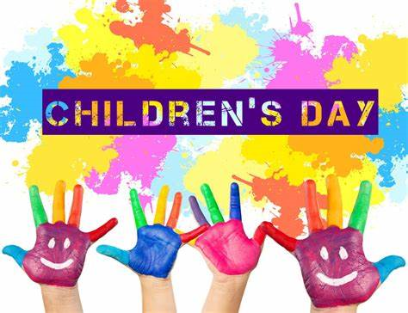

Slide 2
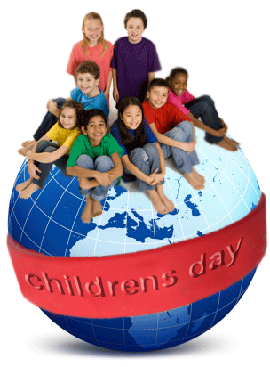
In Poland, children's day is celebrated on June 1. Then festivities and games take place. School trips also take place on this day. Children get presents.

Slide 3
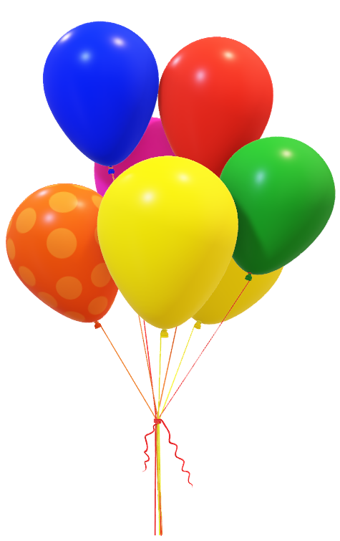
This day is great!!!!!!!

Slide 4
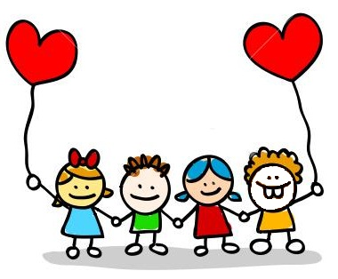


Slide 5

Bibliography
My brain.
Internet.

Slide 6
